Slide 1

Brian Heits
Associate Lead Software Engineer – Edge Professional Services
October 15th – 17th, 2019
Notes:
© Cerner 2016

Slide 2
FHIR Deep Dive

Slide 3
Getting Started: HL7 Community

Slide 4
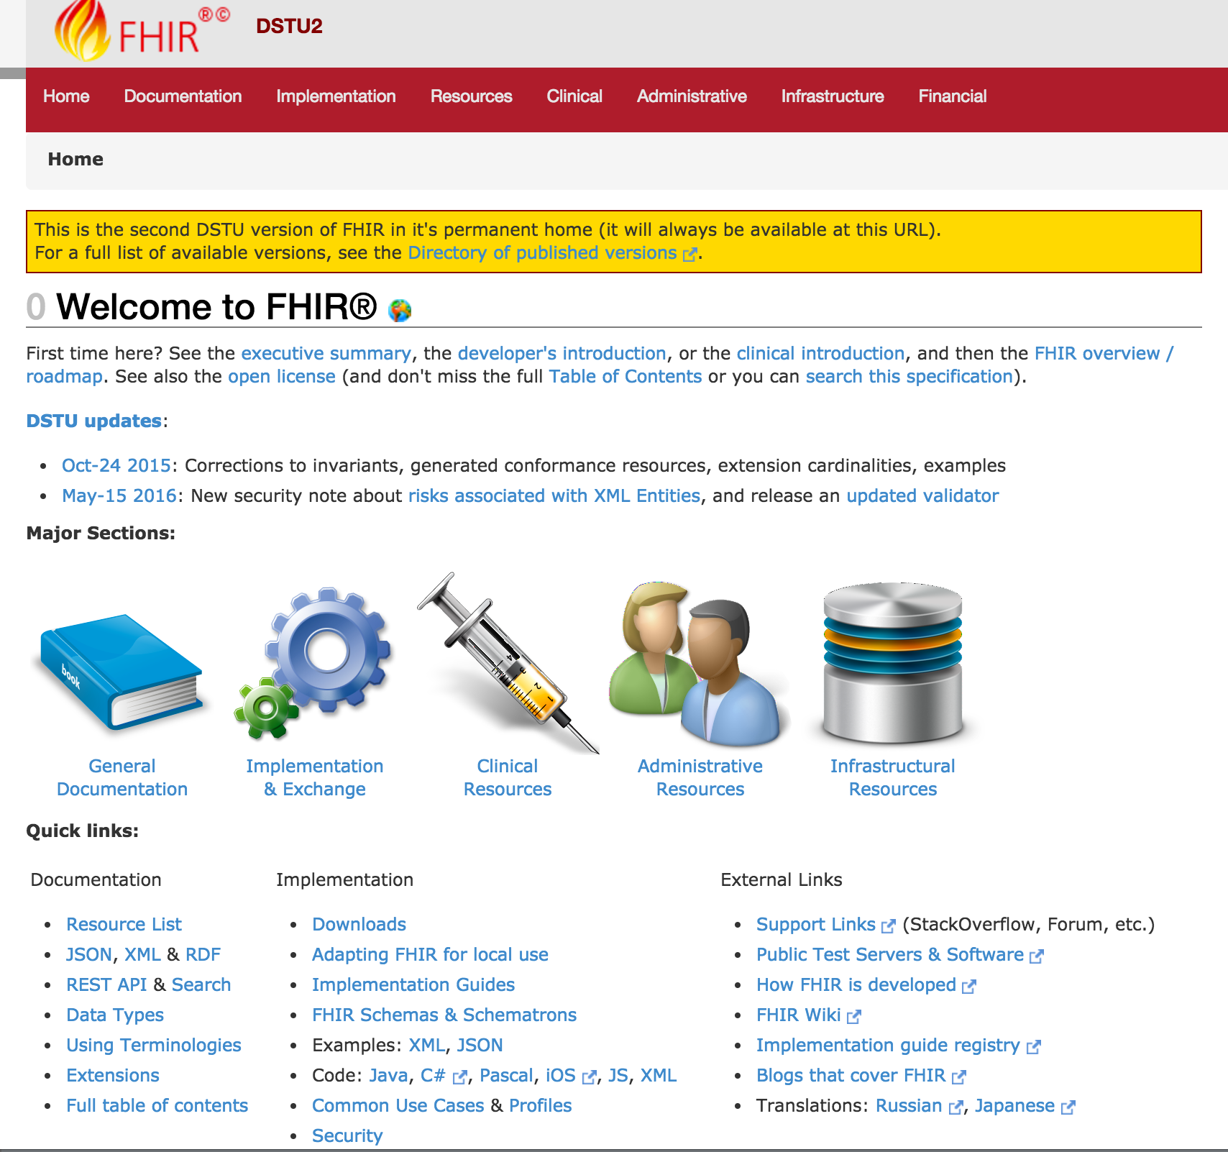






Versioning
Introductions
Support
Cheatsheets & Info
Updates
http://hl7.org/fhir/dstu2/index.html

Slide 5
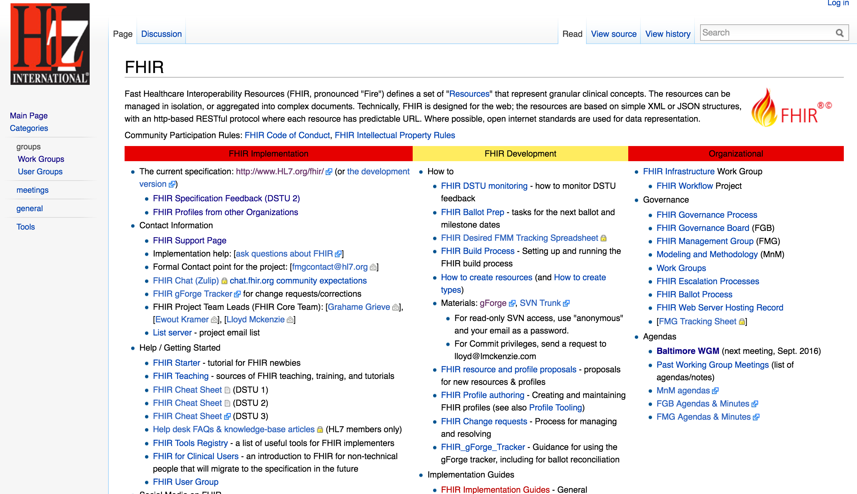
Getting Started
http://wiki.hl7.org/index.php?title=FHIR

Slide 6



Note: HAPI is the recommended Java Reference implementation
http://hapifhir.io/index.html
Resources
Spec Details
Reference Libraries

Slide 7
Specification Versioning

Slide 8
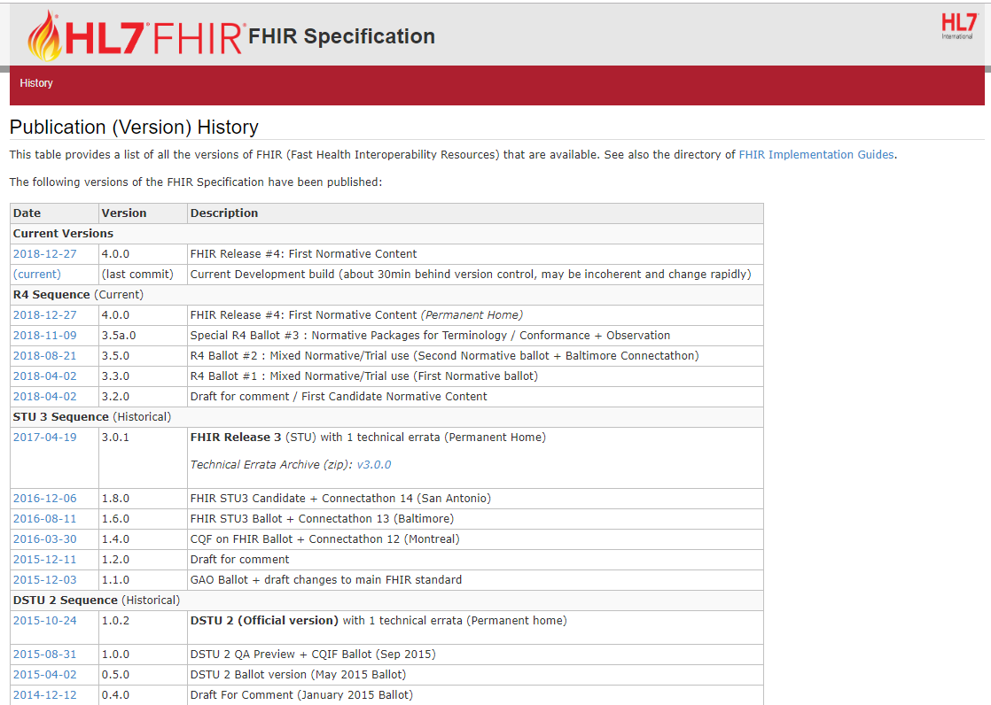
Current: R4 Sequence
AKA: 4.0.0
http://hl7.org/fhir/directory.html

Slide 9

Which Version?
Multiple Available
Deprecate Oldest
Time to Uplift Applications

Slide 10
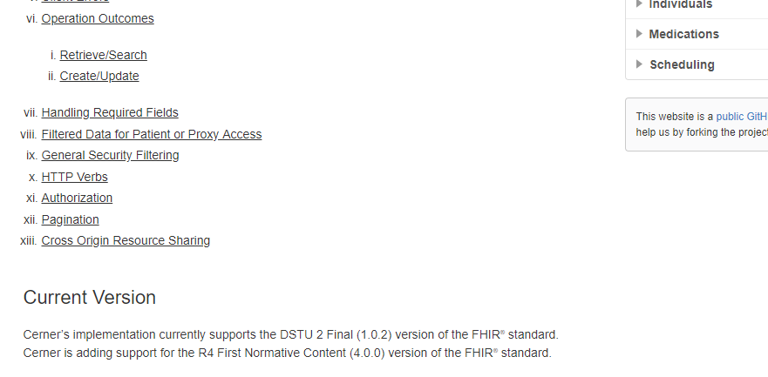
Latest Millennium Production: DSTU2/1.0.2
https://fhir.cerner.com/millennium/dstu2/

Slide 11
Data Types

Slide 12
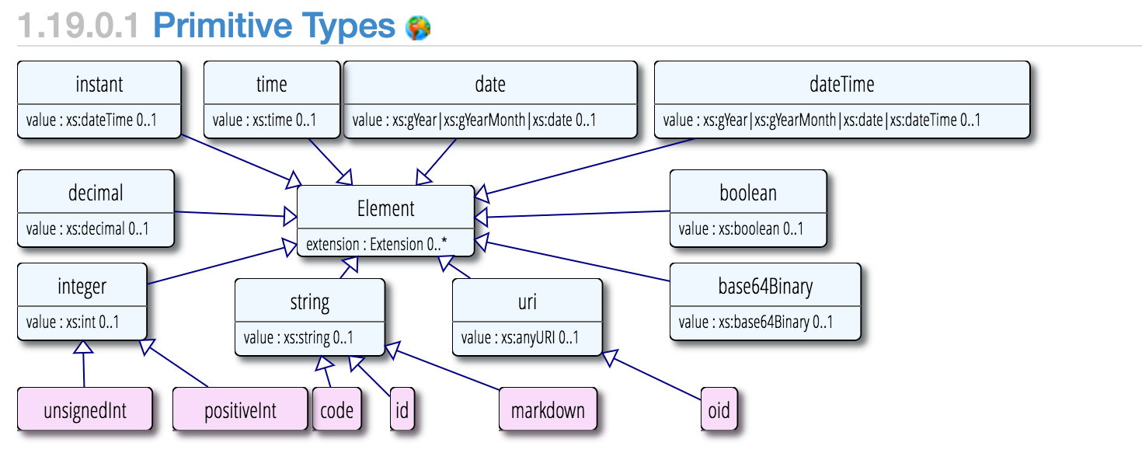
Primitive Types
http://hl7.org/fhir/dstu2/datatypes.html#primitive

Slide 13
Surprises
Decimal: 1.01, 1.010
Instant vs DateTime
DateTime vs Date vs Time
Notes:
Decimals, precision matters (e.g.: use big decimal)
Instant is for machines, DateTime is for humans. Instant MUST have seconds and zone.
DateTime is year, year/month, year/month/day, year/month/day/time (must have zone if there’s a time). Seconds are required (XML definition/schema), but can be ignored or zero.
Date is year, year/month, year/month/day
Time is zone-less, dateless (see you at 8:00 AM every day)

Slide 14
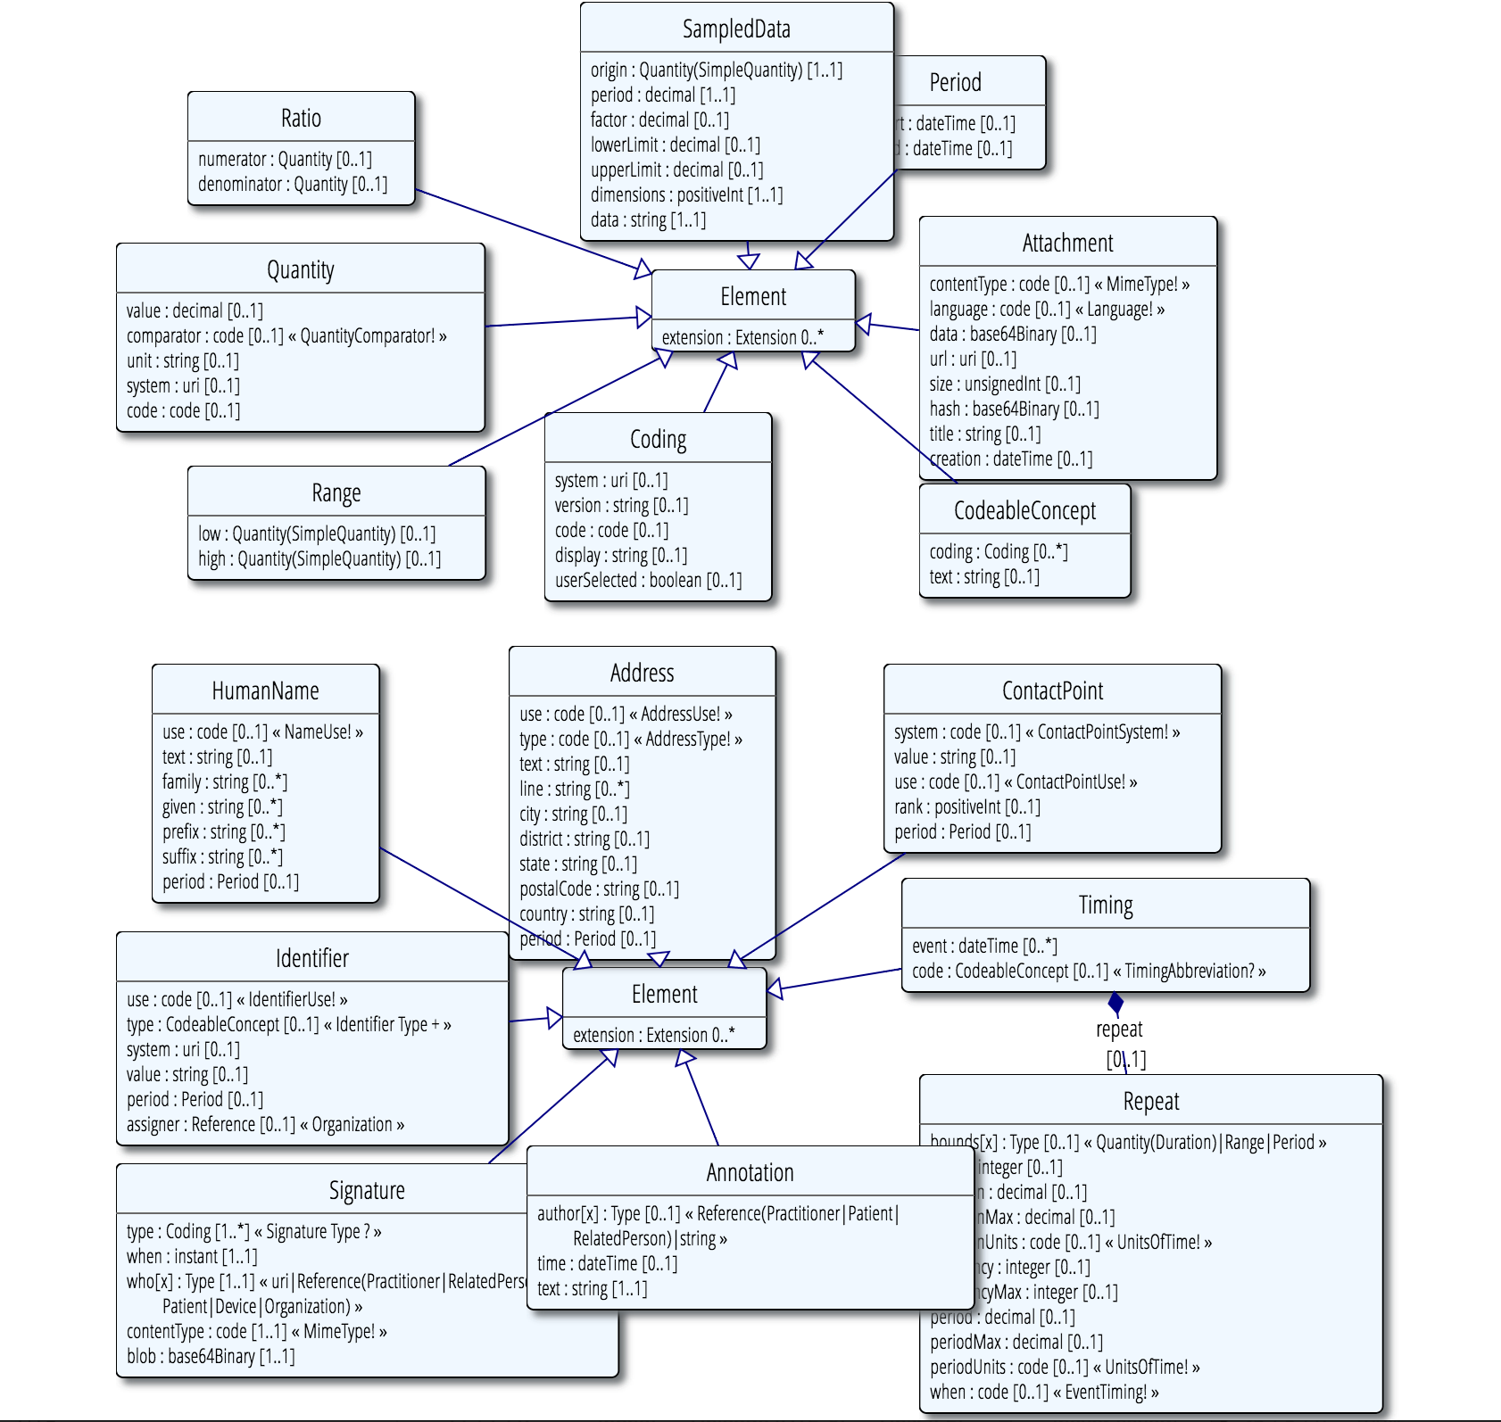
Complex Types
http://hl7.org/fhir/dstu2/datatypes.html#complex

Slide 15
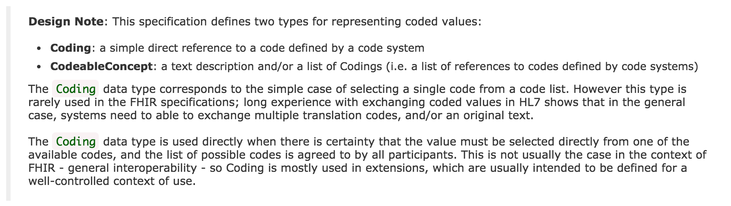
Code Systems
http://hl7.org/fhir/dstu2/datatypes.html#codesystem
Notes:
Code: codified value (usually from a set of values) to represent a concept.
Coding: Code + meta data (e.g., system, version)
CodeableConcept allows you to choose a list of codes, e.g.: multiple terminologies
CodeableConcept references Coding, Coding references a Code.
Code: m, f, unk
Coding: m, + system
CodeableConcept: Relationship type for patient contacts, Observation type (e.g.: height/weight, Loinc, SNOMED)

Slide 16
Formats
JSON and/or XML
Via Accept or Content-Type headers
Via _format parameter
http://hl7.org/fhir/dstu2/http.html#mime-type

Slide 17
Resources

Slide 18
Resources
Patient, Condition, MedicationOrder…
All resources have metadata
All resources have narrative
Structured data items
[base]/[Resource] (case sensitive)
[base]/Patient
http://hl7.org/fhir/dstu2/resource.html

Slide 19
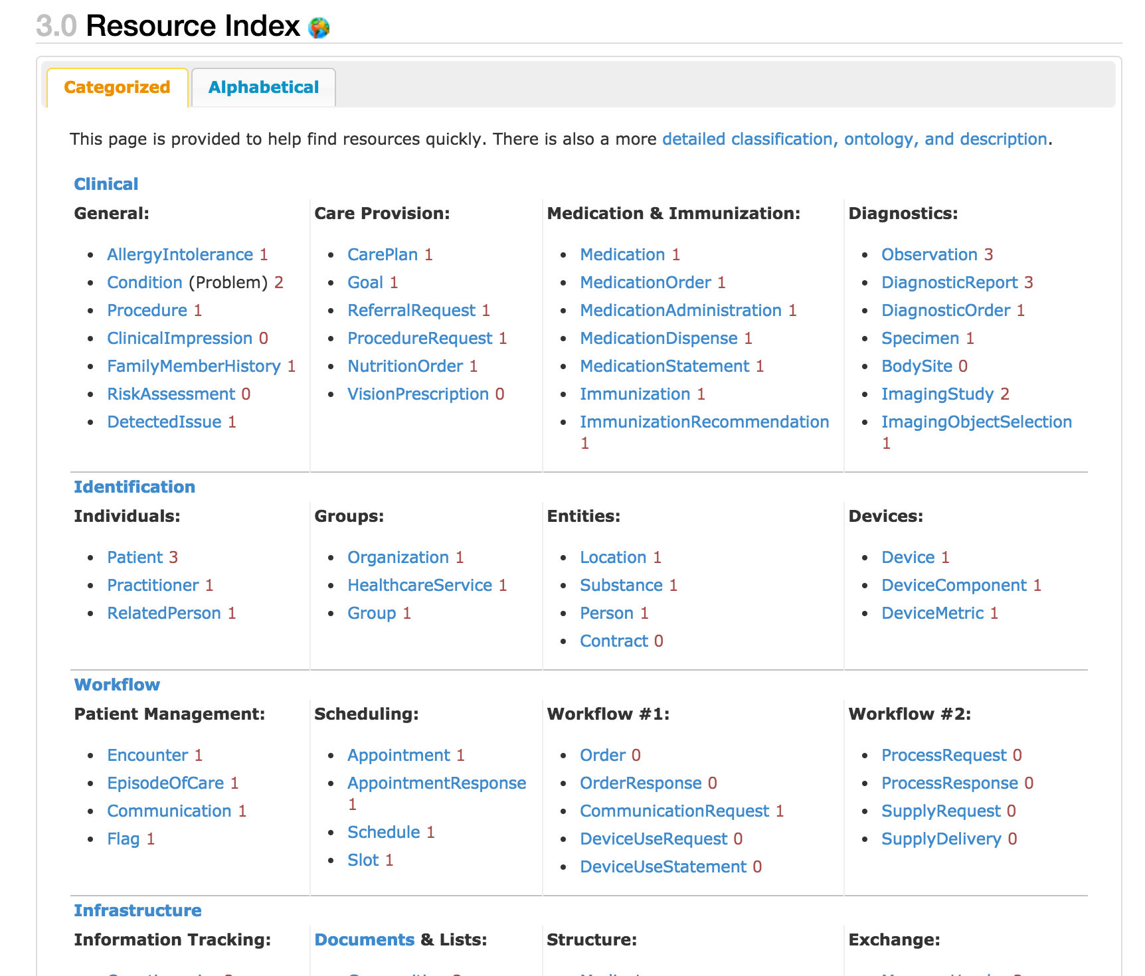
http://hl7.org/fhir/dstu2/resourcelist.html
Notes:
That number to the side…?

Slide 20
Maturity Levels
Risk for change
Lower number, highest risk
0-5
http://hl7.org/fhir/dstu2/resource.html#maturity
Notes:
If you are adverse to change, choose 4+
… which doesn’t exist in DSTU 2

Slide 21
Terminology Bindings

Slide 22
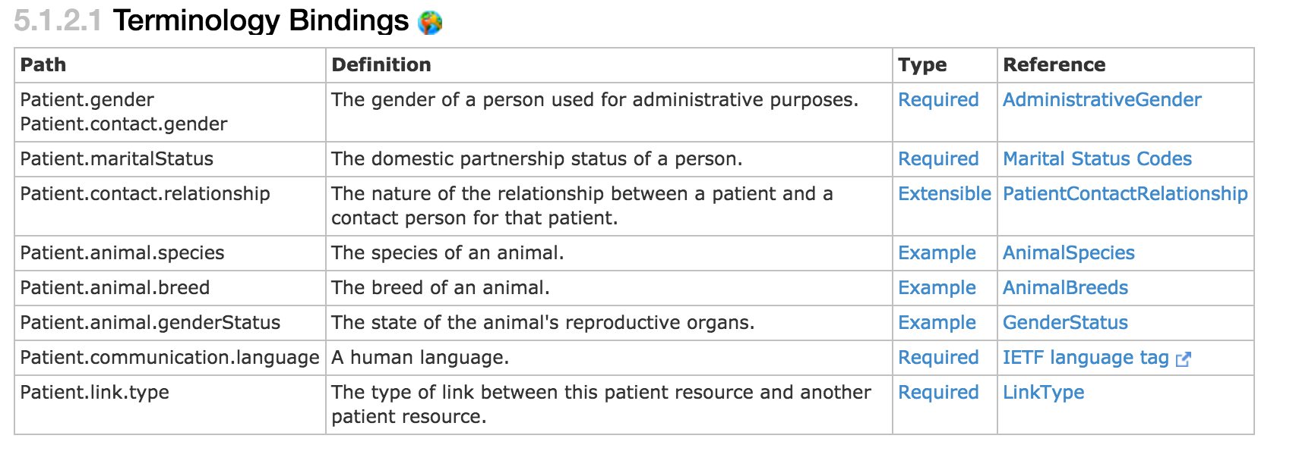
Terminology Bindings
http://hl7.org/fhir/dstu2/patient.html#tx

Slide 23
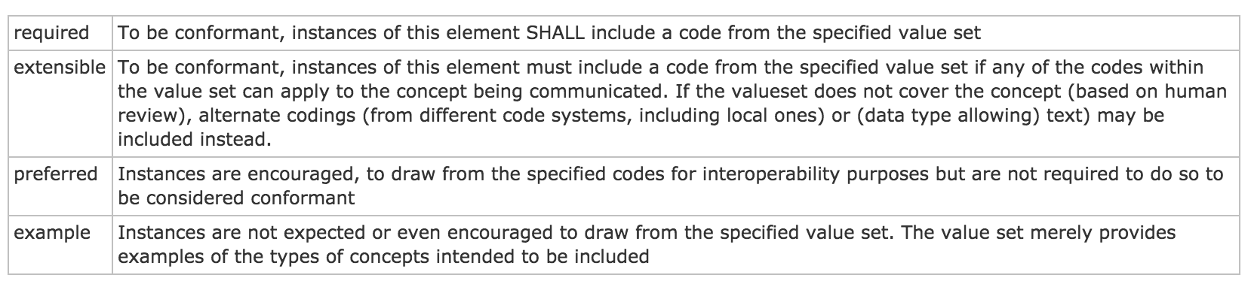
Type/Binding Strength
http://hl7.org/fhir/dstu2/terminologies.html#strength
Notes:
Required: for codeableConcept, you can’t just send “text”

Slide 24
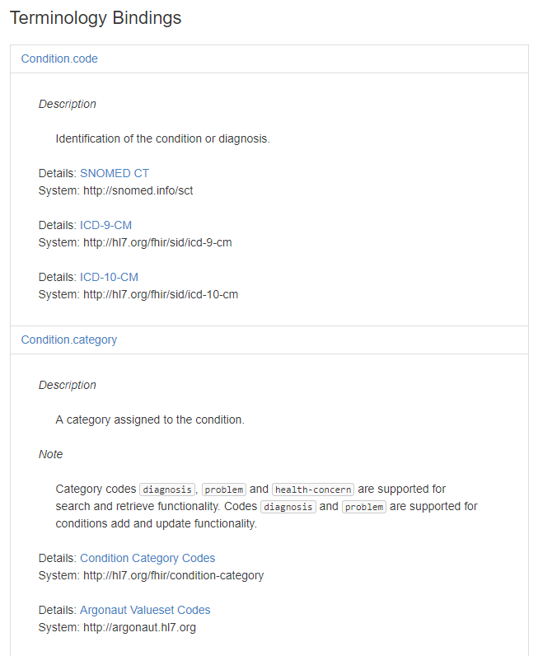
https://fhir.cerner.com/millennium/dstu2/general-clinical/condition/#terminology-bindings
Notes:
If a binding isn’t “required” by core spec, we’ll call out what our binding strength is in documentation

Slide 25
Narrative

Slide 26
“Any resource that is a domain resource (almost all types of resource) may include a human-readable narrative that contains a summary of the resource, and may be used to represent the content of the resource to a human. If narrative is present, it SHALL reflect all content needed for a human to understand the essential clinical and business information otherwise encoded within the resource. Resource definitions may define what content should be represented in the narrative to ensure clinical safety.”
http://hl7.org/fhir/dstu2/narrative.html#Narrative
Notes:
It is often the fall back if a client application doesn’t understand the FHIR resource in question

Slide 27
…”text”: {
"status": "generated",
"div": "<div><table><tbody><tr><td>Name</td><td>Peter James <b>Chalmers</b> (&quot;Jim&quot;)</td></tr><tr><td>Address</td><td>534 Erewhon, Pleasantville, Vic, 3999</td></tr><tr><td>Contacts</td><td>Home: unknown. Work: (03) 5555 6473</td></tr><tr><td>Id</td><td>MRN: 12345 (Acme Healthcare)</td></tr></tbody></table></div>"
}…

Slide 28
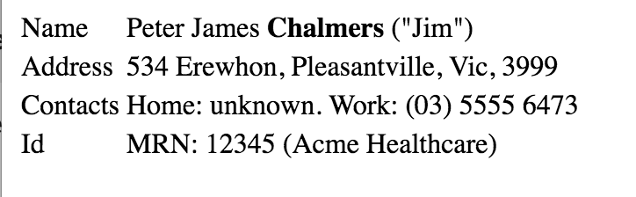

Slide 29
Exercise 1

Slide 30
Exercise 1
Identify the FMM (maturity model) of the Following resources for DSTU 2:
Patient
Condition
Observation
Coverage

Slide 31
Exercise 1: Answer
Identify the FMM (maturity model) of the Following resources for DSTU 2: http://hl7.org/fhir/dstu2/resourcelist.html
Patient: 3
Condition: 2
Observation: 3
Coverage: 0

Slide 32
Exercise 2

Slide 33
Exercise 2
Find out what resources are available in Millennium’s HL7 FHIR DSTU 2 implementation that are not in the May2015 implementation.

Slide 34
Exercise 2: Answer
Appointment
Binary
CarePlan
Contract
Device
Goal
OperationDefinition
Person
Procedure
RelatedPerson
Optional: MedicationOrder (MedicationPrescription was just renamed)

Slide 35
Exercise 3

Slide 36
Exercise 3
What search parameters does the Millennium DSTU 2 implementation of Patient support? Are there any limitations or considerations?

Slide 37
Exercise 3: Answer
Query by: id
Query by: identifier
Query by a combination of: birthdate, name, telecom
_count (paging)
birthdate, name, and telecom has limited availability, and “fuzzy”
There are others (see next slide)
https://fhir.cerner.com/millennium/dstu2/individuals/patient/#parameters

Slide 38
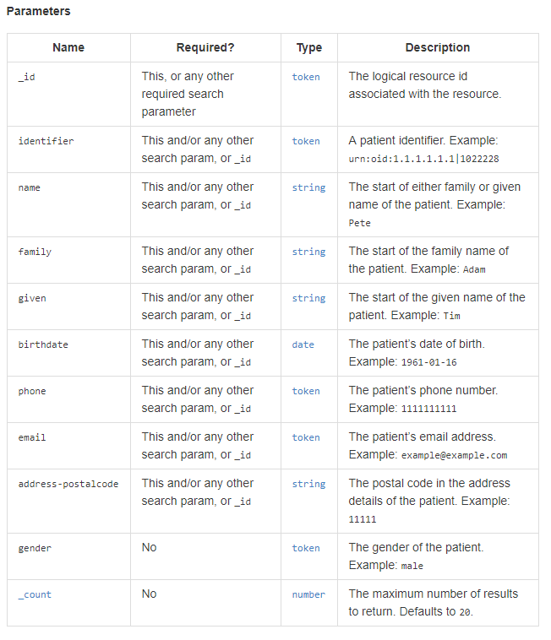

Slide 39
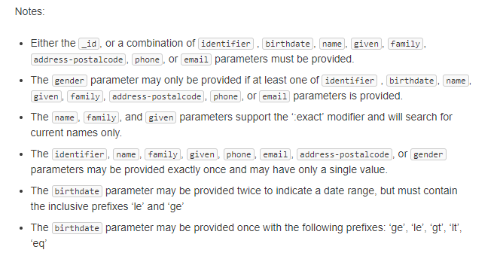

Slide 40
Read

Slide 41
Read
“By ID”
[base]/[Resource]/[id]
[base]/Patient/123ABC
http://hl7.org/fhir/dstu2/http.html#read

Slide 42
id vs identifier
id: logical identifier, must be unique within the FHIR server and resource
identifier: business identifier or “alias”
SSN
MRN
Military ID
http://hl7.org/fhir/dstu2/resource.html#id

Slide 43
Search

Slide 44
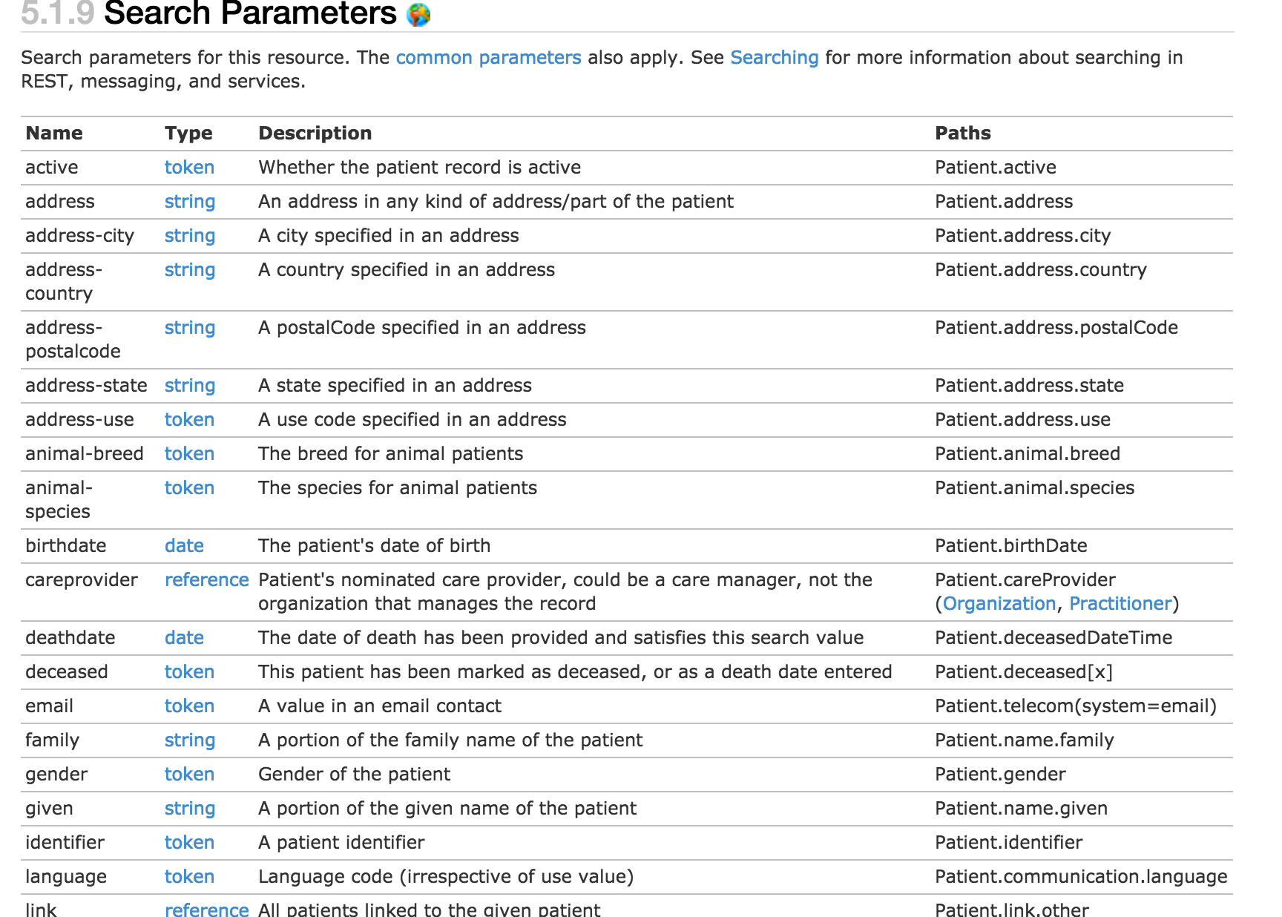
http://hl7.org/fhir/dstu2/patient.html#search

Slide 45
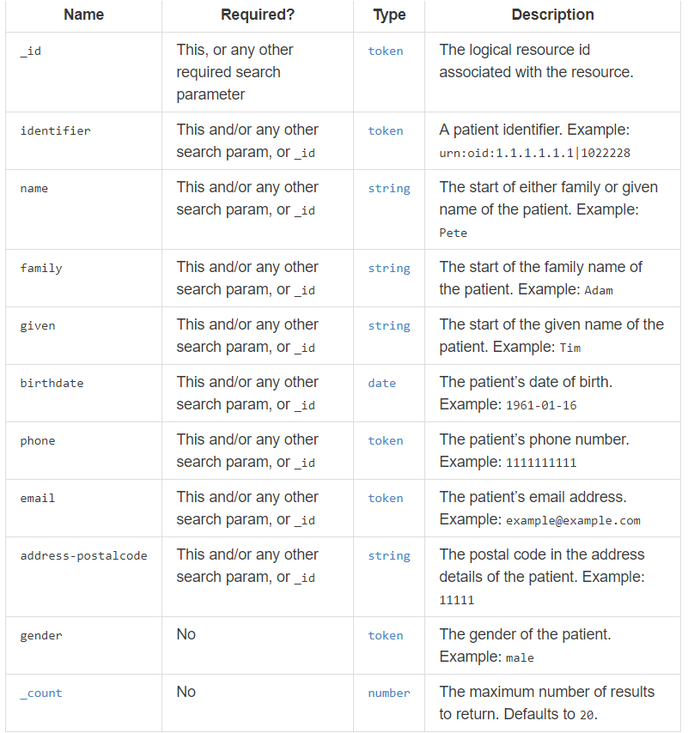
https://fhir.cerner.com/millennium/dstu2/individuals/patient/#parameters

Slide 46
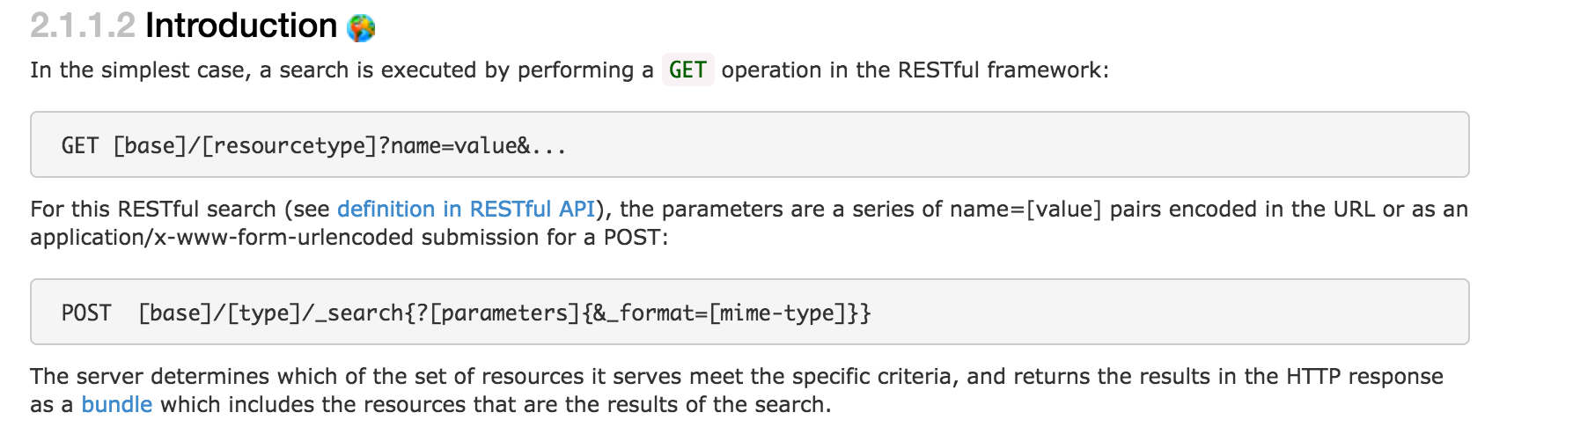
GET [base]/AllergyIntolerance?patient=123
http://hl7.org/fhir/dstu2/search.html
Notes:
This example is searching for all allergies for patient 123

Slide 47
Paging

Slide 48
Paging
Self, First, Previous, Next, Last
Must use link as provided
Changing this has undefined consequences
_count parameter
Less but not more
For interoperability - handle paging
http://hl7.org/fhir/dstu2/http.html#paging
Notes:
Handle paging in the application, which helps ensure you’re run against most servers. Check for the “next” link to see if there are additional pages.

Slide 49
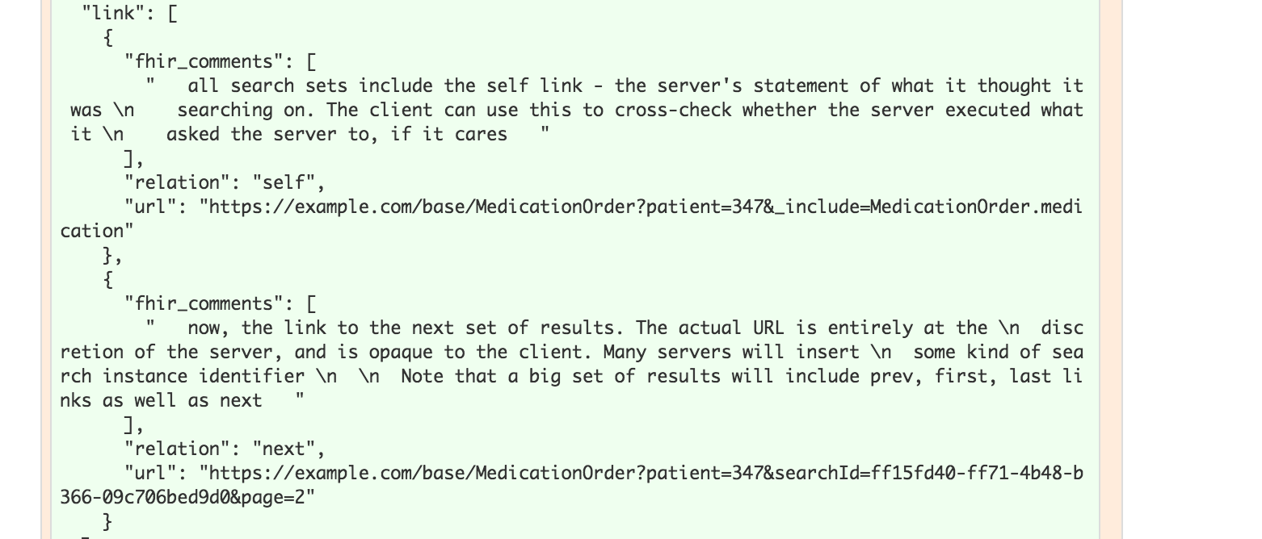
Notes:
The previous link isn’t in this example

Slide 50
Writes

Slide 51
Create
POST [base]/[Resource]
POST [base]/AllergyIntolerance
Body (content-type) must match supported FHIR format
http://hl7.org/fhir/dstu2/http.html#create

Slide 52
Update
PUT [base]/[Resource]/[id]
PUT [base]/AllergyIntolerance/123
Body (content-type) must match supported FHIR format
http://hl7.org/fhir/dstu2/http.html#update

Slide 53
Conditional Update
Optimistic Locking via “If-Match”
Example: Version in database: 2a
Version in “If-Match”: 1a - failure
Version in “If-Match”: 2a - success
http://hl7.org/fhir/dstu2/http.html#2.1.0.10.2

Slide 54
Exercise 4

Slide 55
Exercise 4
Find the patient id for patient Fred Smart

Slide 56
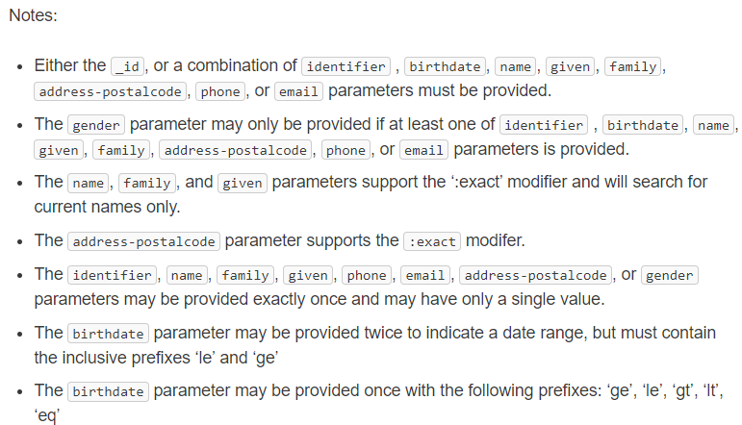
Exercise 4: Answer
Answer: Fuzzy search is pulling any combination of “Smart” or “Fred”
GET https://fhir-open.sandboxcerner.com/dstu2/0b8a0111-e8e6-4c26-a91c-5069cbc6b1ca/Patient?given=Fred&family=Smart&_format=json
Notes:
Note: Its hard to pull exact patient using just the name. Typically use identifier

Slide 57
Exercise 5

Slide 58
Exercise 5
Find out the middle name for Patient Fred Smart (id = 4478007)

Slide 59
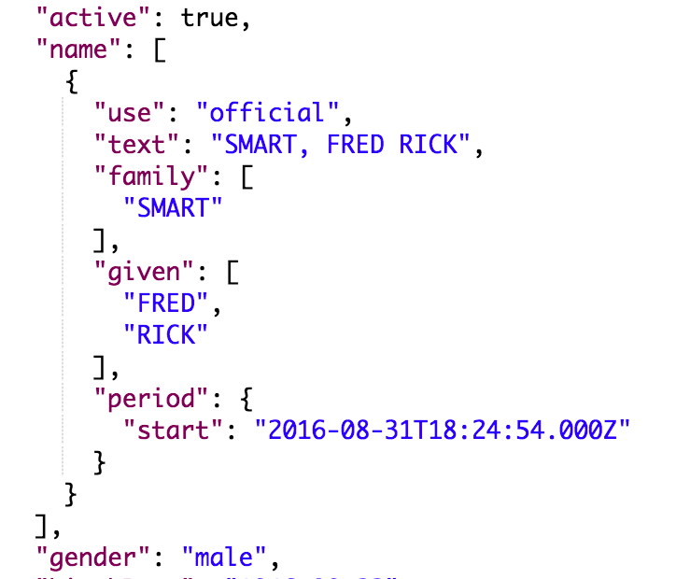
Exercise 5: Answer
Answer: Rick
GET https://fhir-open.sandboxcerner.com/dstu2/0b8a0111-e8e6-4c26-a91c-5069cbc6b1ca/Patient/4478007?_format=json
http://hl7.org/fhir/dstu2/datatypes.html#HumanName (middle is subsequent given name)
Notes:
Note: Patient vs Person. Person represents people “in the real world” for example, it could link to your patient record in many FHIR servers. In CommonWell, most of the core is the “Person” and the records they’re tied to are Patient. We would use Patient here since we’re looking at patient records in an EHR.

Slide 60
Exercise 6

Slide 61
Exercise 6
How many current allergies or intolerances does Tim Peters (id = 1316024) have?
Current: actual or possible existing allergies or intolerances
Hint: What indicates “current” for this FHIR resource?

Slide 62
Exercise 6: Answer
39
GET https://fhir-open.sandboxcerner.com/dstu2/0b8a0111-e8e6-4c26-a91c-5069cbc6b1ca/AllergyIntolerance?patient=1316024&_format=json
GET https://fhir-open.sandboxcerner.com/dstu2/0b8a0111-e8e6-4c26-a91c-5069cbc6b1ca/AllergyIntolerance?patient=1316024&status=active,unconfirmed,confirmed&_format=json
Notes:
Note: AllergyIntolerance/123 is looking up an Allergy by its id (not a patient id). Similarly, AllergyIntolerance?_id=123 is looking up allergy by id, not by the patient id.

Slide 63
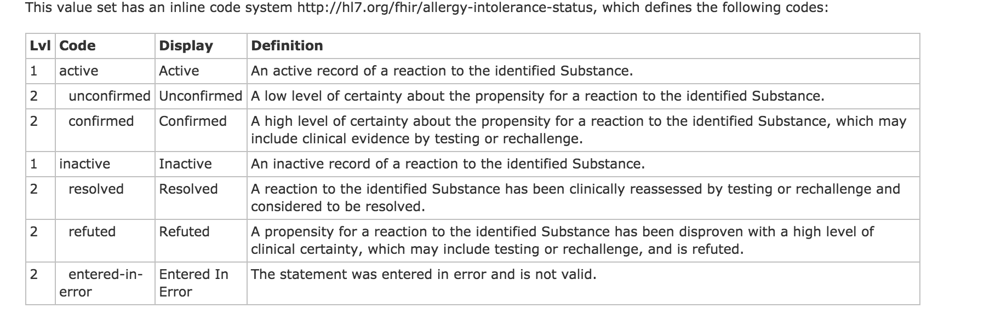
http://hl7.org/fhir/DSTU2/valueset-allergy-intolerance-status.html

Slide 64


What if it wasn’t mapped/known?
http://hl7.org/fhir/dstu2/allergyintolerance.html
Notes:
Be aware that querying by a field that isn’t required may mean that values that weren’t mapped or understood by the FHIR server won’t be returned.
In the Allergy case, STU 3 is addressing this issue with allergies by requiring the status and adding an “unknown” that could be used to ensure all possible allergies can be retrieved.

Slide 65
Exercise 7

Slide 66
Exercise 7
How many different MedicationOrders of Advil Cold and Sinus does Tim Peters (id = 1316024) have?

Slide 67
Exercise 7: Answer
1
GET https://fhir-open.sandboxcerner.com/dstu2/0b8a0111-e8e6-4c26-a91c-5069cbc6b1ca/MedicationOrder?patient=1316024&status=active,on-hold&_format=json

Slide 68
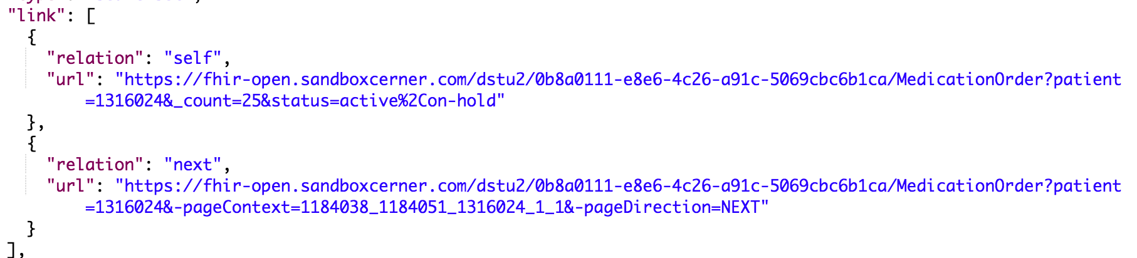
Paging
GET https://fhir-open.sandboxcerner.com/dstu2/0b8a0111-e8e6-4c26-a91c-5069cbc6b1ca/MedicationOrder?patient=1316024&-pageContext=1184038_1184051_1316024_1_1&-pageDirection=NEXT&_format=json
Added _format parameter

Slide 69
Paging
GET https://fhir-open.sandboxcerner.com/dstu2/0b8a0111-e8e6-4c26-a91c-5069cbc6b1ca/MedicationOrder/14203804?_format=json

Slide 70
MedicationStatement?
Could have, though question said order.
Result would have been the same, but statuses would have been “active,intended”

Slide 71
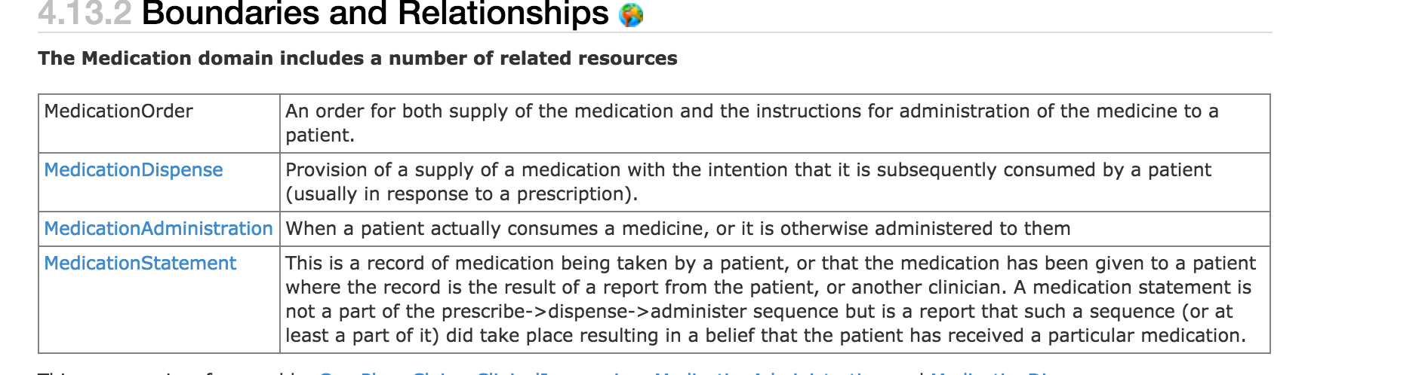
http://hl7.org/fhir/dstu2/medicationorder.html#bnr

Slide 72
Exercise 8

Slide 73
Exercise 8
What is the name of the patient with MRN 10000363
Hint: the system is urn:oid:1.1.1.1.1.1 (oid)

Slide 74
Exercise 8: Answer
Amy Hilton
GET https://fhir-open.sandboxcerner.com/dstu2/0b8a0111-e8e6-4c26-a91c-5069cbc6b1ca/Patient?identifier=urn:oid:1.1.1.1.1.1|10000363&_format=json

Slide 75
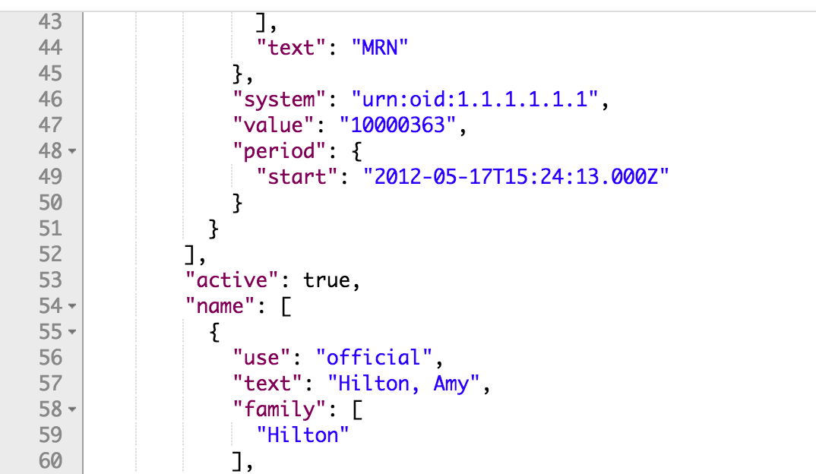

Slide 76
Extensions

Slide 77
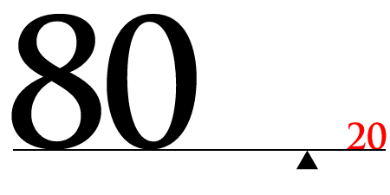
http://hl7.org/fhir/dstu2/extensibility.html

Slide 78
Extension “Rules”
They’re Expected
They can nest
Server/Client cannot reject because of extension
Unless it’s a modifier

Slide 79
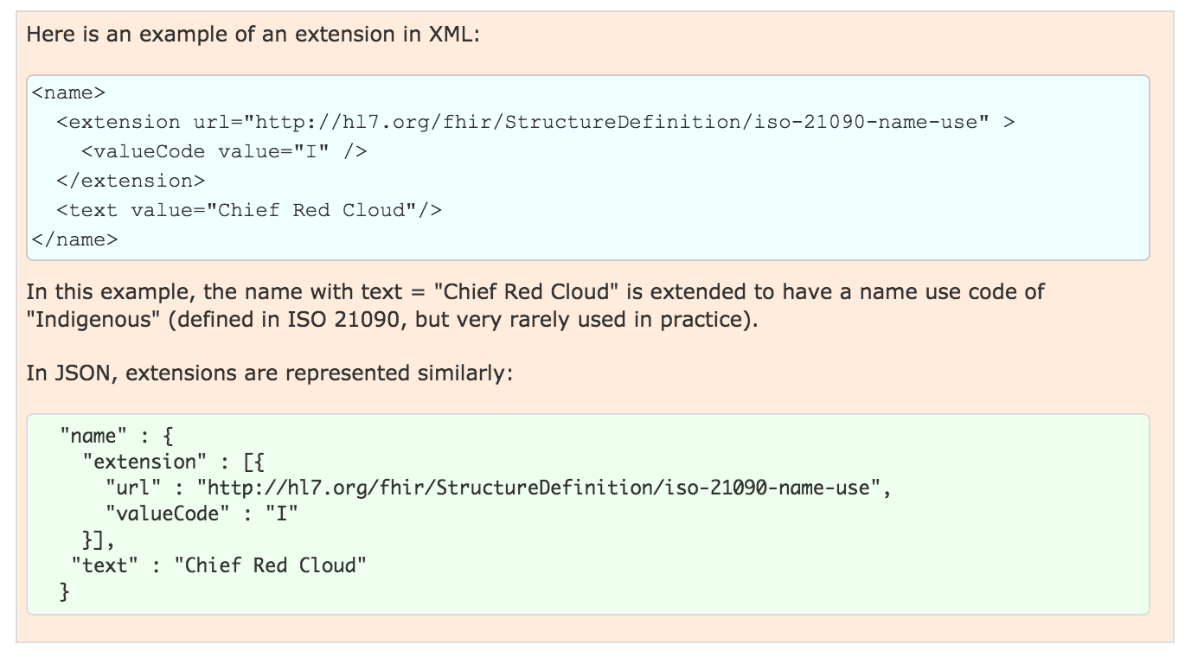
Examples

Slide 80
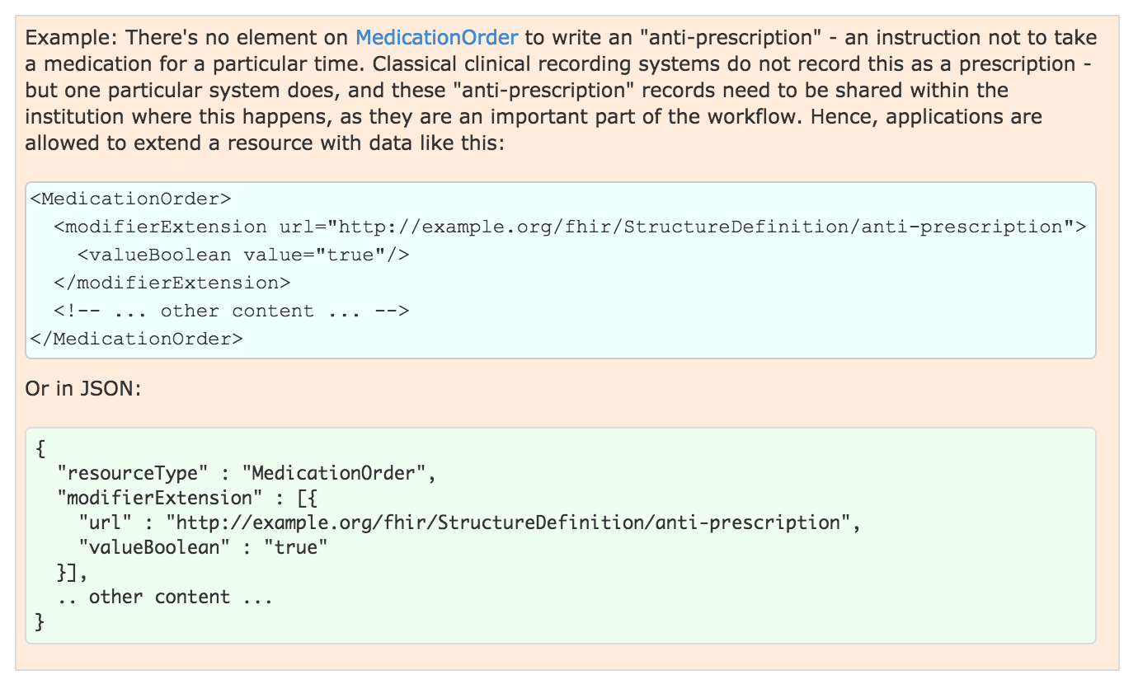
Modifier Example
Notes:
Note: this should show in the narrative

Slide 81
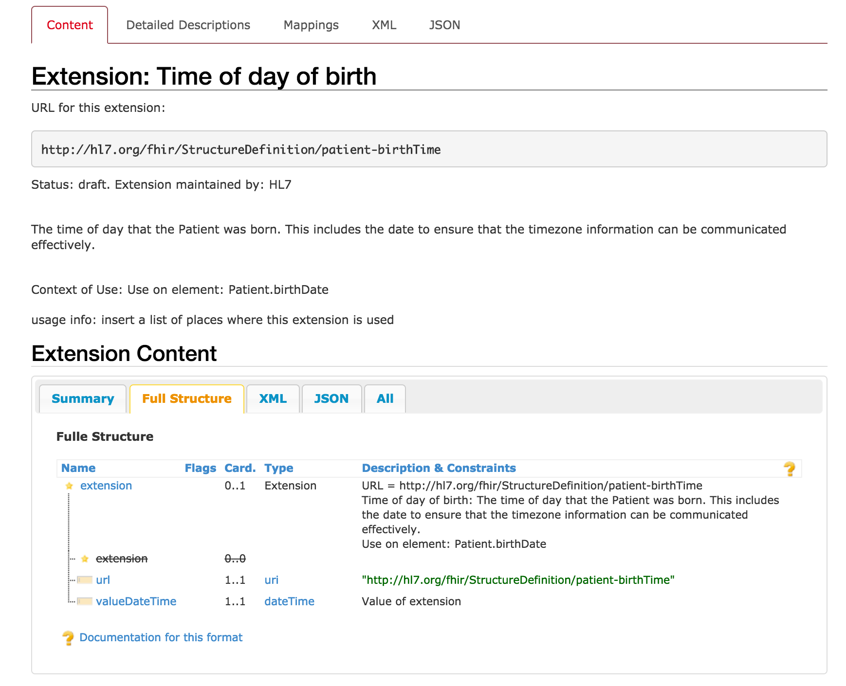
http://hl7.org/fhir/dstu2/extension-patient-birthtime.html
Notes:
Not a modifier
Extension to patient.birthDate

Slide 82
Conformance

Slide 83
Conformance Resource
Weird: located at [base]/Conformance [base]/metadata
Describes the Server
Step towards auto-config
http://hl7.org/fhir/dstu2/conformance.html
Notes:
Can be used to describe other things, like desired implementations or capabilities, we’ll concentrate on describing a FHIR server contract.
Not enough to completely configure, but a step in that direction

Slide 84

What?
Which operations?
Which parameters?
Which formats?
Profiles…
Notes:
It defines a large part of the contract

Slide 85
Exercise 9

Slide 86
Exercise 9
Which extensions are supported by the Millennium DSTU 2 Patient resource?

Slide 87
Exercise 9: Answer
Time of day of birth
Argonaut Ethnicity
Argonaut Patient Birth Sex
Argonaut Race
Rendered Value
https://fhir.cerner.com/millennium/dstu2/individuals/patient/#extensions

Slide 88
Exercise 10

Slide 89
Exercise 10
According to the Conformance statement, does this FHIR server support OAuth? https://fhir-open.sandboxcerner.com/dstu2/0b8a0111-e8e6-4c26-a91c-5069cbc6b1ca/
Notes:
Note: Make sure to remove spaces in your URL for FHIR - there should be none, and having spaces in the server URL will cause errors. HTTP URLs are space and case sensitive.

Slide 90
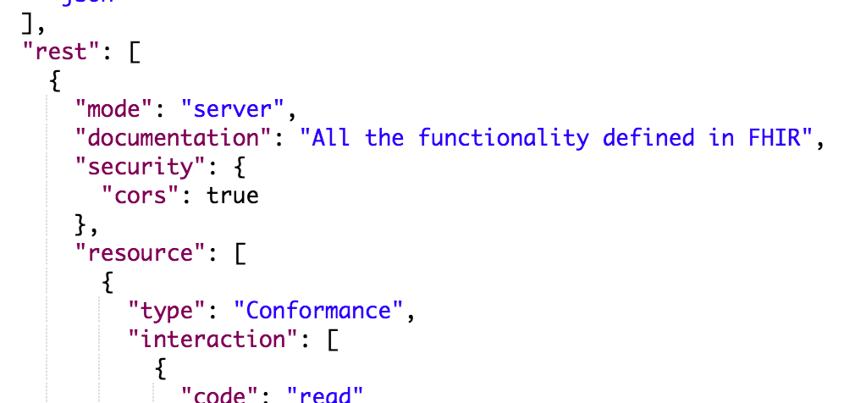

Exercise 10: Answer
Answer: No (it’s our open endpoint)
GET https://fhir-open.sandboxcerner.com/dstu2/0b8a0111-e8e6-4c26-a91c-5069cbc6b1ca/metadata?_format=json

Slide 91
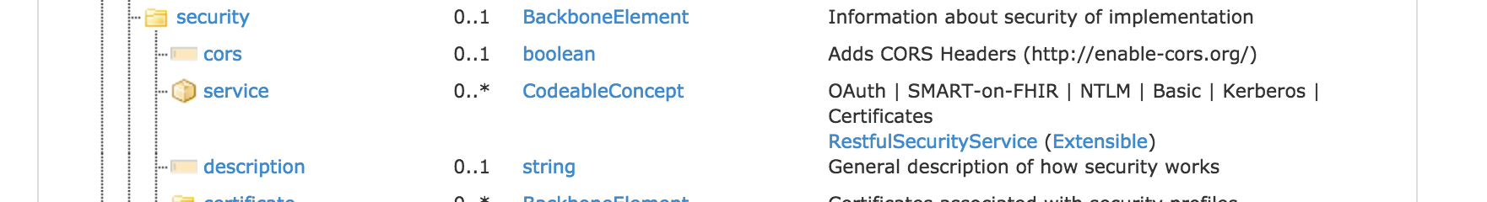

http://hl7.org/fhir/dstu2/conformance.html

Slide 92
Profiles

Slide 93
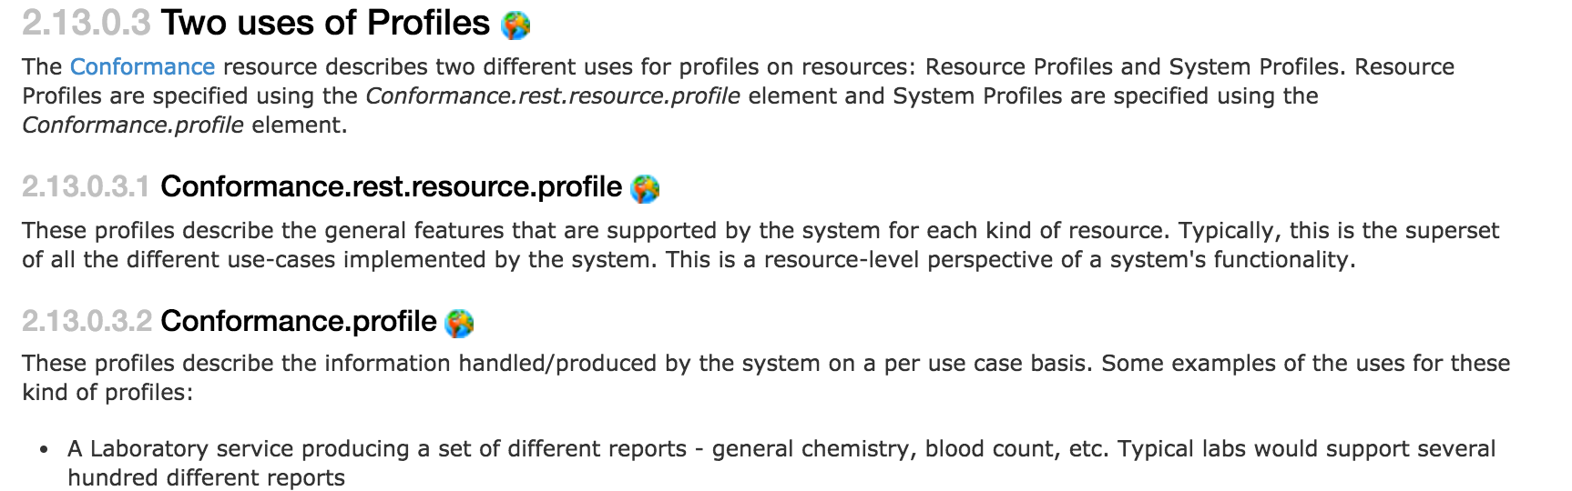
What
http://hl7.org/fhir/dstu2/profiling.html
Notes:
StructureDefinition resource (in DSTU 2)
Detailed description of contracts, per user case or per system

Slide 94
Rules
Detailed contract
Parameters, operations, api calls
Fields, cardinality
Terminology binding, extensions
Must be compatible with core
Can’t change required binding
Cardinality can restrict more (1..* to 1..1 but not 0..*)
Can’t rename fields
Notes:
Compatible: If core binds as required, you can’t change it
If core has 1..*, you can’t change to 0..*, but can change to 1..1
Goal: must be safe to process a resource without the profile

Slide 95
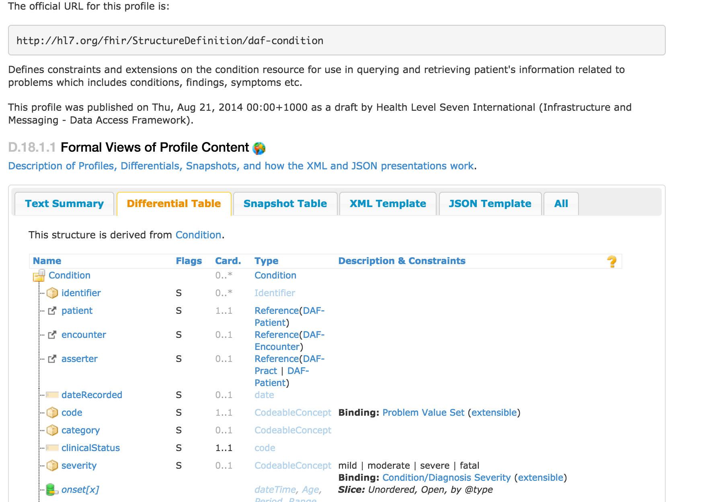
DAF Condition
http://hl7.org/fhir/dstu2/daf/daf-condition.html
Notes:
Part of an Implementation Guide (DAF)
Differential is good at showing differences from core
“Must Support” - it’s fuzzy…
This profile binds Condition.code to a value set, binds severity

Slide 96
Argonaut IG
http://www.fhir.org/guides/argonaut/r2/
Standard Profiles for defined use cases
Address issues from the JASON Task Force reports
http://hl7.org/fhir/dstu2/iglist.html

Slide 97
Questions?

Slide 98
More Exercises!

Slide 99
Exercise 11

Slide 100
Exercise 11
Does Nancy Smart (id = 4342010) have a normal blood pressure?
Hint: LOINC 55284-4 can be used to find blood pressures

Slide 101
Exercise 11: Answer
It’s normal
GET https://fhir-open.sandboxcerner.com/dstu2/0b8a0111-e8e6-4c26-a91c-5069cbc6b1ca/Observation?patient=4342010&code=http://loinc.org|8480-6,http://loinc.org|8462-4&_format=json (code: http://loinc.org|8480-6,http://loinc.org|8462-4)
GET https://fhir-open.sandboxcerner.com/dstu2/0b8a0111-e8e6-4c26-a91c-5069cbc6b1ca/Observation?patient=4342010&code=http://loinc.org|55284-4&_format=json(code: http://loinc.org|55284-4)
Notes:
You need to ensure you properly escape/encode the URL so that protected characters are percent encoded. This is to ensure that the server can interpret the URL correctly. Postman does this for you, and *some* http libraries will, but make sure your code (or app) handles this logic to encode or decode as needed.

Slide 102
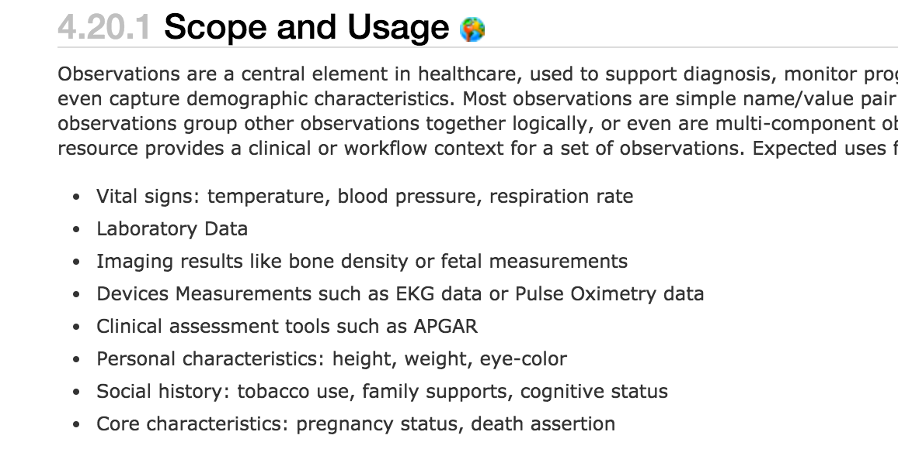
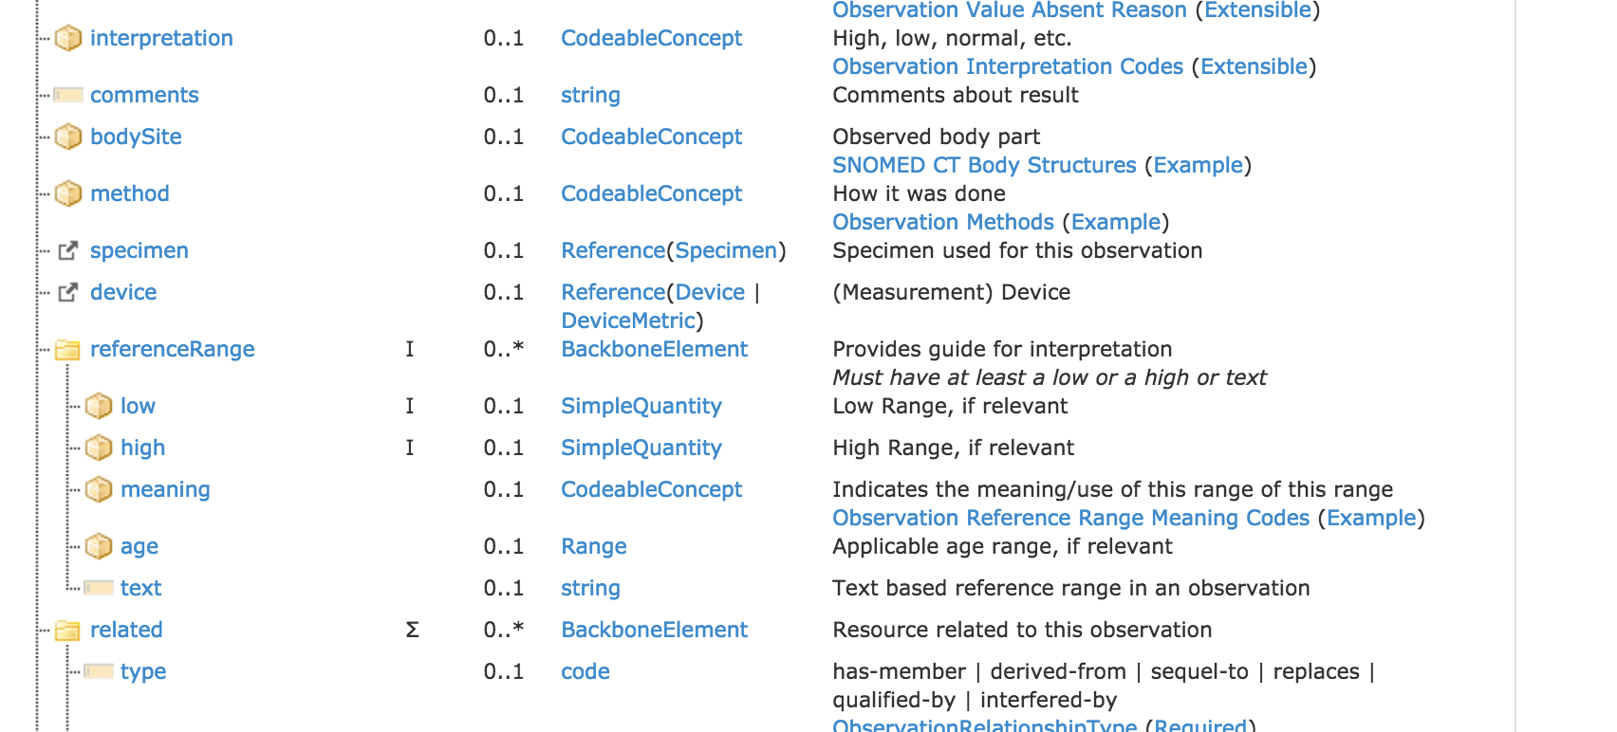
http://hl7.org/fhir/dstu2/observation.html

Slide 103
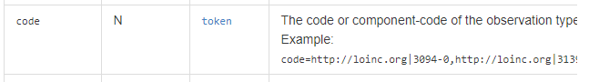
http://fhir.cerner.com/millennium/dstu2/diagnostic/observation/#parameters

Slide 104
Exercise 12

Slide 105
Exercise 12
Is Fred Smart (id = 4478007) currently taking insulin?

Slide 106
Exercise 12: Answer
Answer: No
GET https://fhir-open.sandboxcerner.com/dstu2/0b8a0111-e8e6-4c26-a91c-5069cbc6b1ca/MedicationStatement?patient=4478007&status=active&_format=json
GET https://fhir-open.sandboxcerner.com/dstu2/0b8a0111-e8e6-4c26-a91c-5069cbc6b1ca/MedicationOrder?patient=4478007&status=active&_format=json

Slide 107
Exercise 13

Slide 108
Exercise 13
Who has a pacemaker: Tim Peters (id = 1316024) or Fred Smart (id = 4478007)?
Hint: Pacemaker name is “Medtronic Advisa MRI SureScan”

Slide 109
Exercise 13: Answer
Fred
GET https://fhir-open.sandboxcerner.com/dstu2/0b8a0111-e8e6-4c26-a91c-5069cbc6b1ca/Device?patient=4478007&_format=json
and possibly Google (Medtronic Advisa MRI SureScan)
GET https://fhir-open.sandboxcerner.com/dstu2/0b8a0111-e8e6-4c26-a91c-5069cbc6b1ca/Device?patient=1316024&_format=json

Slide 110
Exercise 14

Slide 111
Exercise 14
Who is patient Tim Peter’s (id = 1316024) son?

Slide 112
Exercise 14: Answer
Answer: Cooper, Timothy
GET https://fhir-open.sandboxcerner.com/dstu2/0b8a0111-e8e6-4c26-a91c-5069cbc6b1ca/RelatedPerson?patient=1316024&_format=json

Slide 113
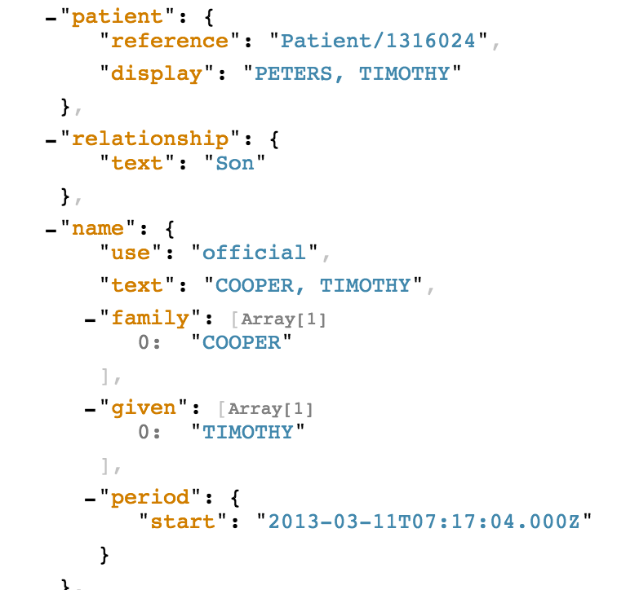

Slide 114
Exercise 15

Slide 115
Exercise 15
What happens when you query MedicationStatement for Joe Smart (id = 4342010) and filter by a status of draft? Why?

Slide 116
Exercise 15: Answer
Answer: An error (400), because draft isn’t in the value set
GET https://fhir-open.sandboxcerner.com/dstu2/0b8a0111-e8e6-4c26-a91c-5069cbc6b1ca/MedicationStatement?patient=4342010&status=draft&_format=json
https://fhir.cerner.com/millennium/dstu2/medications/medication-statement/#terminology-bindings

Slide 117
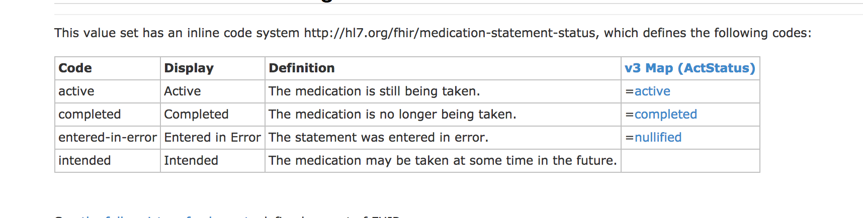
http://hl7.org/fhir/DSTU2/valueset-medication-statement-status.html

Slide 118
